Slide 1

Web Application Development
COMP-229

Slide 2
Integrating Backend API
Users should be able to use the frontend views to fetch and modify user data in the database based on authentication and authorization.
To implement these functionalities, the React components will access the API endpoints that are exposed by the backend using the Fetch API.
The Fetch API is a newer standard that makes network requests similar to XMLHttpRequest (XHR) but using promises instead, enabling a simpler and cleaner API.
To learn more about the Fetch API,
visit https://developer.mozilla.org/en-US/docs/Web/API/Fetch_API

Slide 3
Fetch for user CRUD
In the client/user/api-user.js file, we will add methods for accessing each of the user CRUD API endpoints, which the React components can use to exchange user data with the server and database as required.
In the following sections, we will look at the implementation of these methods and how they correspond to each CRUD endpoint.

Slide 4
CREATE – creating new user
The create method will take user data from the view component, which is where we will invoke this method. Then, it will use fetch to make a POST call at the create API route, '/api/users', to create a new user in the backend with the provided data.
Finally, in this method, we return the response from the server as a promise. So, the component calling this method can use this promise to handle the response appropriately, depending on what is returned from the server.

Slide 5
LIST – Listing users
Similarly, we will implement the list method next.
The list method will use fetch to make a GET call to retrieve all the users in the database, and then return the response from the server as a promise to the component.
The returned promise, if it resolves successfully, will give the component an array containing the user objects that were retrieved from the database.
In the case of a single user read, we will deal with a single user object instead, as demonstrated next.

Slide 6
Reading a user profile
The read method will use fetch to make a GET call to retrieve a specific user by ID.
Since this is a protected route, besides passing the user ID as a parameter, the requesting component must also provide valid credentials, which, in this case, will be a valid JWT received after a successful sign-in.
mern-skeleton/client/user/api-user.js:

Slide 7
The JWT is attached to the GET fetch call in the Authorization header using the Bearer scheme, and then the response from the server is returned to the component in a promise.
This promise, when it resolves, will either give the component the user details for the specific user or notify that access is restricted to authenticated users.
Similarly, the updated user API method also needs to be passed valid JWT credentials for the fetch call, as shown in the next section.

Slide 8
UPDATE - Updating a user's data
The update method will take changed user data from the view component for a specific user, then use fetch to make a PUT call to update the existing user in the backend.
This is also a protected route that will require a valid JWT as the credential.

Slide 9
As we have seen with the other fetch calls, this method will also return a promise containing the server's response to the user update request.
In the final method, we will learn how to call the user delete API.

Slide 10
Deleting a user
The remove method will allow the view component to delete a specific user from the database and use fetch to make a DELETE call.
This, again, is a protected route that will require a valid JWT as a credential, similar to the read and update methods.
mern-skeleton/client/user/api-user.js:

Slide 11
The response from the server to the delete request will be returned to the component as a promise, as in the other methods.
In these five helper methods, we have covered calls to all the user CRUD-related API endpoints that we implemented on the backend.
Finally, we can export these methods from the api-user.js file as follows.
mern-skeleton/client/user/api-user.js:
export { create, list, read, update, remove }

Slide 12
Updated mern-skeleton/client/user/api-user.js:
const create = async (user) => {
try {
let response = await fetch('/api/users/', {
method: 'POST',
headers: {
'Accept': 'application/json',
'Content-Type': 'application/json'
},
body: JSON.stringify(user)
})
return await response.json()
} catch(err) {
console.log(err)
}
}
const list = async (signal) => {
try {
let response = await fetch('/api/users/', {
method: 'GET',
signal: signal,
})
return await response.json()
} catch(err) {
console.log(err)
}
}
const read = async (params, credentials, signal) => {
try {
let response = await fetch('/api/users/' + params.userId, {
method: 'GET',
signal: signal,
headers: {
'Accept': 'application/json',
'Content-Type': 'application/json',
'Authorization': 'Bearer ' + credentials.t
}
})
return await response.json()
} catch(err) {
console.log(err)
}
}
const update = async (params, credentials, user) => {
try {
let response = await fetch('/api/users/' + params.userId, {
method: 'PUT',
headers: {
'Accept': 'application/json',
'Content-Type': 'application/json',
'Authorization': 'Bearer ' + credentials.t
},
body: JSON.stringify(user)
})
return await response.json()
} catch(err) {
console.log(err)
}
}
const remove = async (params, credentials) => {
try {
let response = await fetch('/api/users/' + params.userId, {
method: 'DELETE',
headers: {
'Accept': 'application/json',
'Content-Type': 'application/json',
'Authorization': 'Bearer ' + credentials.t
}
})
return await response.json()
} catch(err) {
console.log(err)
}
}
export { create, list, read, update, remove }

Slide 13
These user CRUD methods can now be imported and used by the React components as required.
Next, we will implement similar helper methods to integrate the auth-related API endpoints.

Slide 14
Fetch for the auth API
In order to integrate the auth API endpoints from the server with the frontend
React components, we will add methods for fetching sign-in and sign-out API
endpoints in the client/lib/api-auth.js file. Let's take a look at them.

Slide 15
Sign-in
The signin method will take user sign-in data from the view component, then use fetch to make a POST call to verify the user with the backend.
mern-skeleton/client/lib/api-auth.js:

Slide 16
The response from the server will be returned to the component in a promise, which may provide the JWT if sign-in was successful.
The component invoking this method needs to handle the response appropriately, such as storing the received JWT locally so it can be used when making calls to other protected API routes from the frontend.
We will look at the implementation for this when we implement the Sign In view later.
After the user is successfully signed in, we also want the option to call the signout API when the user is signing out.
The call to the signout API is discussed next.

Slide 17
Sign-out
We will add a signout method to api-auth.js, which will use fetch to make a GET call to the signout API endpoint on the server.
mern-skeleton/client/lib/api-auth.js:

Slide 18
This method will also return a promise to inform the component about whether the API request was successful.
At the end of the api-auth.js file, we will export the signin and signout methods.
mern-skeleton/client/lib/api-auth.js:
export { signin, signout }

Slide 19
Updated mern-skeleton/client/lib/api-auth.js:
const signin = async (user) => {
try {
let response = await fetch('/auth/signin/', {
method: 'POST',
headers: {
'Accept': 'application/json',
'Content-Type': 'application/json'
},
credentials: 'include',
body: JSON.stringify(user)
})
return await response.json()
} catch(err) {
console.log(err)
}
}
const signout = async () => {
try {
let response = await fetch('/auth/signout/', { method: 'GET' })
return await response.json()
} catch(err) {
console.log(err)
}
}
export { signin, signout }

Slide 20
Now, these methods can be imported into the relevant React components so that we can implement the user sign-in and signout features.
With these API fetch methods added, the React frontend has complete access to the endpoints we made available in the backend.
Before we start putting these methods to use in our React components, we will look into how user auth state can be maintained across the frontend.

Slide 21
Adding auth in the frontend
As we discussed earlier, implementing authentication with JWT relinquishes responsibility to the client-side to manage and store user auth state.
To this end, we need to write code that will allow the client-side to store the JWT that's received from the server on successful sign-in, make it available when accessing protected routes, delete or invalidate the token when the user signs out, and also restrict access to views and components on the frontend based on the user auth state.

Slide 22
Using examples of the auth workflow from the React Router documentation, in the following sections, we will write helper methods to manage the auth state across the components, and also use a custom PrivateRoute component to add protected routes to the frontend of the MERN skeleton application.

Slide 23
Managing auth state
To manage auth state in the frontend of the application, the frontend needs to be able to store, retrieve, and delete the auth credentials that are received from the server on successful user sign in.
In our MERN applications, we will use the browser's sessionsStorage as the storage option to store the JWT auth credentials.
Alternatively, you can use localStorage instead of sessionStorage to store the JWT credentials.
With sessionStorage, the user auth state will only be remembered in the current window tab.
With localStorage, the user auth state will be remembered across tabs in a browser.

Slide 24
In client/auth/auth-helper.js, we will define the helper methods discussed in the following sections to store and retrieve JWT credentials from client-side sessionStorage, and also clear out the sessionStorage on user sign-out.

Slide 25
Saving credentials
In order to save the JWT credentials that are received from the server on successful sign-in, we use the authenticate method, which is defined as follows.
mern-skeleton/client/lib/auth-helper.js:

Slide 26
The authenticate method takes the JWT credentials, jwt, and a callback function, cb, as arguments.
It stores the credentials in sessionStorage after ensuring window is defined, in other words ensuring this code is running in a browser and hence has access to sessionStorage.
Then, it executes the callback function that is passed in. This callback will allow the component – in our case, the component where sign-in is called – to define actions that should take place after successfully signing in and storing credentials.
Next, we will discuss the method that lets us access these stored credentials.

Slide 27
Retrieving credentials
In our frontend components, we will need to retrieve the stored credentials to check if the current user is signed in.
In the isAuthenticated() method, we can retrieve these credentials from sessionStorage.
mern-skeleton/client/lib/auth-helper.js:

Slide 28
A call to isAuthenticated() will return either the stored credentials or false, depending on whether credentials were found in sessionStorage.
Finding credentials in storage will mean a user is signed in, whereas not finding credentials will mean the user is not signed in. We will also add a method that allows us to delete the credentials from storage when a signed-in user signs out from the application.

Slide 29
Deleting credentials
When a user successfully signs out from the application, we want to clear the stored JWT credentials from sessionStorage.
This can be accomplished by calling the clearJWT method, which is defined in the following code.
mern-skeleton/client/lib/auth-helper.js:

Slide 30
Updated mern-skeleton/client/lib/auth-helper.js:
authenticate(jwt, cb) {
if(typeof window !== "undefined")
sessionStorage.setItem('jwt', JSON.stringify(jwt))
cb()
}
isAuthenticated() {
if (typeof window == "undefined")
return false
if (sessionStorage.getItem('jwt'))
return JSON.parse(sessionStorage.getItem('jwt'))
else
return false
}
clearJWT(cb) {
if(typeof window !== "undefined")
sessionStorage.removeItem('jwt')
cb()
signout().then((data) => {
document.cookie = "t=; expires=Thu, 01 Jan 1970 00:00:00 UTC; path=/;"
})
}

Slide 31
Updated mern-skeleton/client/lib/auth-helper.js:
import { signout } from './api-auth.js'
const auth = {
isAuthenticated() {
if (typeof window == "undefined")
return false
if (sessionStorage.getItem('jwt'))
return JSON.parse(sessionStorage.getItem('jwt'))
else
return false
},
authenticate(jwt, cb) {
if (typeof window !== "undefined")
sessionStorage.setItem('jwt', JSON.stringify(jwt))
cb()
},
clearJWT(cb) {
if (typeof window !== "undefined")
sessionStorage.removeItem('jwt')
cb()
//optional
signout().then((data) => {
document.cookie = "t=; expires=Thu, 01 Jan 1970 00:00:00 UTC; path=/;"
})
}
}
export default auth

Slide 32
This clearJWT method takes a callback function as an argument, and it removes the JWT credential from sessionStorage.
The passed in cb() function allows the component initiating the signout functionality to dictate what should happen after a successful sign-out.
The clearJWT method also uses the signout method we defined earlier in api-auth.js to call the signout API in the backend.
If we had used cookies to store the credentials instead of sessionStorage, the response to this API call would be where we clear the cookie, as shown in the preceding code.

Slide 33
Using the signout API call is optional since this is dependent on whether cookies are used as the credential storage mechanism.
With these three methods, we now have ways of storing, retrieving, and deleting JWT credentials on the client-side.
Using these methods, the React components we build for the frontend will be able to check and manage user auth state to restrict access in the frontend, as demonstrated in the following section with the custom PrivateRoute component.

Slide 34
The PrivateRoute component
The code in the file defines the PrivateRoute component, as shown in the auth flow example at https://reacttraining.com/react-router/web/example/auth-workflow, which can be found in the React Router documentation.
It will allow us to declare protected routes for the frontend to restrict view access based on user auth.

Slide 35
mern-skeleton/client/lib/PrivateRoute.jsx:
import React from 'react';
import { Route, Navigate, useLocation } from 'react-router-dom';
import auth from './auth-helper';
const PrivateRoute = ({ children, ...rest }) => {
const location = useLocation();
return auth.isAuthenticated() ? (
children
) : (
<Navigate
to="/signin"
state={{ from: location }}
replace
/>
);
};
export default PrivateRoute;

Slide 36
Components to be rendered in this PrivateRoute will only load when the user is authenticated, which is determined by a call to the isAuthenticated method; otherwise, the user will be redirected to the Signin component.
We load the components that should have restricted access, such as the user profile component, in a PrivateRoute.
This will ensure that only authenticated users are able to view the user profile page.
With the backend APIs integrated and the auth management helper methods ready for use in the components, we can now start building the remaining view components that utilize these methods and complete the frontend.

Slide 37
Completing the User frontend
The React components that will be described in this section complete the interactive features we defined for the skeleton by allowing users to view, create, and modify user data stored in the database with respect to auth restrictions.
The components we will implement are as follows:
Users: To fetch and list all users from the database to the view
Signup: To display a form that allows new users to sign up
Signin: To display a form that allows existing users to sign in
Profile: To display details for a specific user after retrieving from the database

Slide 38
EditProfile: To display details for a specific user and allow authorized user to update these details
DeleteUser: To allow an authorized user to delete their account from the application
Menu: To add a common navigation bar to each view in the application.
For each of these components, we will go over their unique aspects, as well as how to add them to the application in the MainRouter.

Slide 39
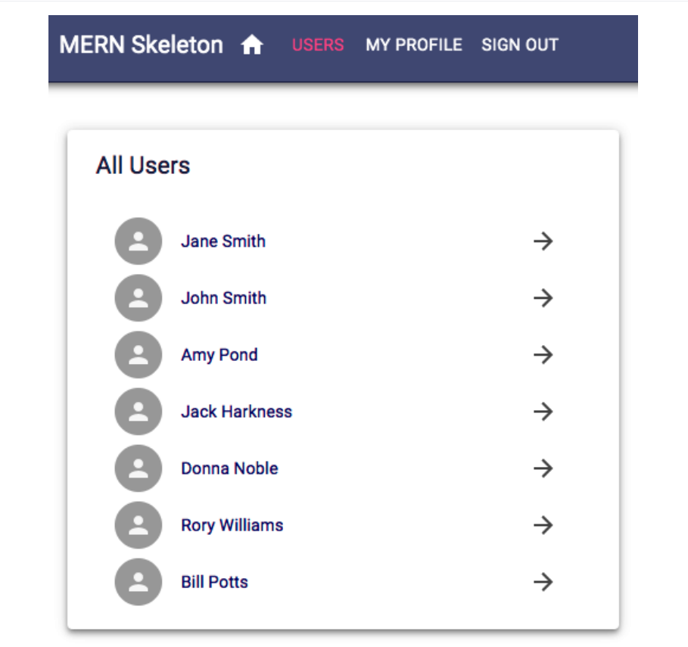
The Users component
The Users component in client/user/Users.jsx shows the names of all the users that have been fetched from the database and links each name to the user profile.
The following component can be viewed by any visitor to the application and will render at the '/users' route:

Slide 40
import React from 'react'
import {useState} from 'react'
import {useEffect} from 'react'
import { makeStyles } from '@material-ui/core/styles'
import Card from '@material-ui/core/Card'
import Paper from '@material-ui/core/Paper'
import List from '@material-ui/core/List'
import {list} from './api-user.js'
import { Link as RouterLink } from 'react-router-dom';
import Link from '@material-ui/core/Link'
import ListItem from '@material-ui/core/ListItem'
import ListItemAvatar from '@material-ui/core/ListItemAvatar'
import ListItemText from '@material-ui/core/ListItemText'
import ListItemSecondaryAction from '@material-ui/core/ListItemSecondaryAction'
import IconButton from '@material-ui/core/IconButton'
import Avatar from '@material-ui/core/Avatar'
//import Person from '@material-ui/core/Person'
//import ArrowForward from '@material-ui/core/ArrowForward'
import CardContent from '@material-ui/core/CardContent'
import CardMedia from '@material-ui/core/CardMedia'
import Typography from '@material-ui/core/Typography'
//import ArrowForward from '@material-ui/core/ArrowForward'
import ArrowForward from '@material-ui/icons/ArrowForward';
import unicornbikeImg from './../assets/images/unicornbikeImg.jpg'
const useStyles = makeStyles(theme => ({
card: {
// Define your card styles here
},
textField: {
// Define your text field styles here
},
error: {
// Define your error icon styles here
},
submit: {
// Define your submit button styles here
},
title: {
// Define your title styles here
},
root: {
// Define your root styles here
},
}));
export default function Users() {
const [users, setUsers] = useState([])
useEffect(() => {
const abortController = new AbortController()
const signal = abortController.signal
list(signal).then((data) => {
console.log(data)
if (data && data.error) {
console.log(data.error)
} else {
console.log(data)
setUsers(data)
}
})
return function cleanup(){
abortController.abort()
}
}, [])
const classes = useStyles()
return (
<Paper className={classes.root} elevation={4}>
<Typography variant="h6" className={classes.title}>
All Users
</Typography>
<List dense>
{users.map((item, i) => {
return <Link component={RouterLink} to={"/user/" + item._id} key={i}>
<ListItem button>
<ListItemAvatar>
<Avatar>
</Avatar>
</ListItemAvatar>
<ListItemText primary={item.name}/>
<ListItemSecondaryAction>
<IconButton>
<ArrowForward/>
</IconButton>
</ListItemSecondaryAction>
</ListItem>
</Link>
})}
</List>
</Paper>
)
}

Slide 41
Updated mern-skeleton/client/user/Users.jsx:
import React from 'react'
import {useState} from 'react'
import {useEffect} from 'react'
import { makeStyles } from '@material-ui/core/styles'
import Card from '@material-ui/core/Card'
import Paper from '@material-ui/core/Paper'
import List from '@material-ui/core/List'
import {list} from './api-user.js'
import { Link as RouterLink } from 'react-router-dom';
import Link from '@material-ui/core/Link'
import ListItem from '@material-ui/core/ListItem'
import ListItemAvatar from '@material-ui/core/ListItemAvatar'
import ListItemText from '@material-ui/core/ListItemText'
import ListItemSecondaryAction from '@material-ui/core/ListItemSecondaryAction'
import IconButton from '@material-ui/core/IconButton'
import Avatar from '@material-ui/core/Avatar'
//import Person from '@material-ui/core/Person'
//import ArrowForward from '@material-ui/core/ArrowForward'
import CardContent from '@material-ui/core/CardContent'
import CardMedia from '@material-ui/core/CardMedia'
import Typography from '@material-ui/core/Typography'
//import ArrowForward from '@material-ui/core/ArrowForward'
import ArrowForward from '@material-ui/icons/ArrowForward';
import unicornbikeImg from './../assets/images/unicornbikeImg.jpg'
const useStyles = makeStyles(theme => ({
card: {
// Define your card styles here
},
textField: {
// Define your text field styles here
},
error: {
// Define your error icon styles here
},
submit: {
// Define your submit button styles here
},
title: {
// Define your title styles here
},
root: {
// Define your root styles here
},
}));
export default function Users() {
const [users, setUsers] = useState([])
useEffect(() => {
const abortController = new AbortController()
const signal = abortController.signal
list(signal).then((data) => {
console.log(data)
if (data && data.error) {
console.log(data.error)
} else {
console.log(data)
setUsers(data)
}
})
return function cleanup(){
abortController.abort()
}
}, [])
const classes = useStyles()
return (
<Paper className={classes.root} elevation={4}>
<Typography variant="h6" className={classes.title}>
All Users
</Typography>
<List dense>
{users.map((item, i) => {
return <Link component={RouterLink} to={"/user/" + item._id} key={i}>
<ListItem button>
<ListItemAvatar>
<Avatar>
</Avatar>
</ListItemAvatar>
<ListItemText primary={item.name}/>
<ListItemSecondaryAction>
<IconButton>
<ArrowForward/>
</IconButton>
</ListItemSecondaryAction>
</ListItem>
</Link>
})}
</List>
</Paper>
)
}

Slide 42
Explanation:
Imports:
Import necessary modules from React and Material-UI.
Import the list method from api-user.js.
Styles:
Use makeStyles to define custom styles for the component.
Component:
Define the Users component using a functional component.
Use the useState hook to manage the users state.
Use the useEffect hook to fetch user data when the component mounts.
Fetch User Data:
Inside useEffect, define an AbortController to handle cleanup.
Call the list method to fetch users and set the users state.
Handle potential errors by logging them.

Slide 43
Render:
Return a Paper component containing a Typography component for the title and a List component to display users.
Map over the users array to create a list of ListItem components.
Use Link from Material-UI to wrap ListItem for navigation.
Include Avatar with a default image and ArrowForward icon for better UI.
Notes:
Ensure the unicornbikeImg path is correct for the Avatar source.
The styles in useStyles can be further customized based on your specific design requirements.
This implementation assumes the list function from api-user.js returns a promise that resolves to the user data.

Slide 44
To add this Users component to the React application, we need to update the MainRouter component with a Route that renders this component at the '/users' path.
mern-skeleton/client/MainRouter.jsx:
<Route path="/users" element={Users}/>

Slide 45
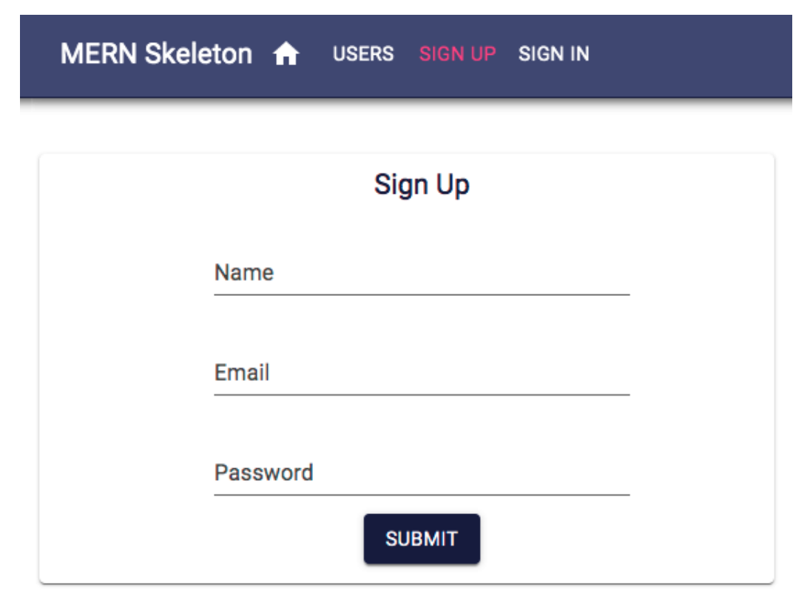
The Signup component
The Signup component in client/user/Signup.jsx presents a form with name, email, and password fields to the user for sign-up at the '/signup' path, as displayed in the following screenshot:

Slide 46
Updated mern-skeleton/client/user/Signup.jsx:
import React, { useState } from 'react';
import { makeStyles } from '@material-ui/core/styles';
import { Card, CardContent, Typography, TextField, CardActions, Button, Dialog, DialogTitle, DialogContent, DialogContentText, DialogActions } from '@material-ui/core';
import { Link } from 'react-router-dom';
import PropTypes from 'prop-types';
import { create } from './api-user';
const useStyles = makeStyles(theme => ({
card: {
maxWidth: 400,
margin: '0 auto',
marginTop: theme.spacing(3),
padding: theme.spacing(2),
textAlign: 'center',
},
textField: {
width: '100%',
marginBottom: theme.spacing(2),
},
error: {
color: 'red',
},
submit: {
margin: '0 auto',
marginBottom: theme.spacing(2),
},
title: {
fontSize: 18,
},
}));
// const create = async (user) => {
// return { error: null }; // Simulated API call
// };
export default function Signup() {
const classes = useStyles();
const [values, setValues] = useState({
name: '',
password: '',
email: '',
});
const [open, setOpen] = useState(false);
const handleChange = name => event => {
setValues({ ...values, [name]: event.target.value });
};
const handleClose = () => {
setOpen(false);
};
const clickSubmit = () => {
const user = {
name: values.name || undefined,
email: values.email || undefined,
password: values.password || undefined,
};
create(user).then((data) => {
if (data.error) {
setValues({ ...values, error: data.error });
} else {
setOpen(true);
}
});
};
Signup.propTypes = {
open: PropTypes.bool.isRequired,
handleClose: PropTypes.func.isRequired,
};
return (
<div>
<Card className={classes.card}>
<CardContent>
<Typography variant="h6" className={classes.title}>
Sign Up
</Typography>
<TextField
id="name"
label="Name"
className={classes.textField}
value={values.name}
onChange={handleChange('name')}
margin="normal"
/>
<TextField
id="email"
label="Email"
className={classes.textField}
value={values.email}
onChange={handleChange('email')}
margin="normal"
/>
<TextField
id="password"
label="Password"
className={classes.textField}
value={values.password}
onChange={handleChange('password')}
type="password"
margin="normal"
/>
</CardContent>
<CardActions>
<Button color="primary" variant="contained" onClick={clickSubmit}
className={classes.submit}>
Submit
</Button>
</CardActions>
</Card>
<Dialog open={open} onClose={handleClose}>
<DialogTitle>New Account</DialogTitle>
<DialogContent>
<DialogContentText>
New account successfully created.
</DialogContentText>
</DialogContent>
<DialogActions>
<Link to="/Signin">
<Button color="primary" autoFocus variant="contained" onClick={handleClose}>
Sign In
</Button>
</Link>
</DialogActions>
</Dialog>
</div>
);
}

Slide 47
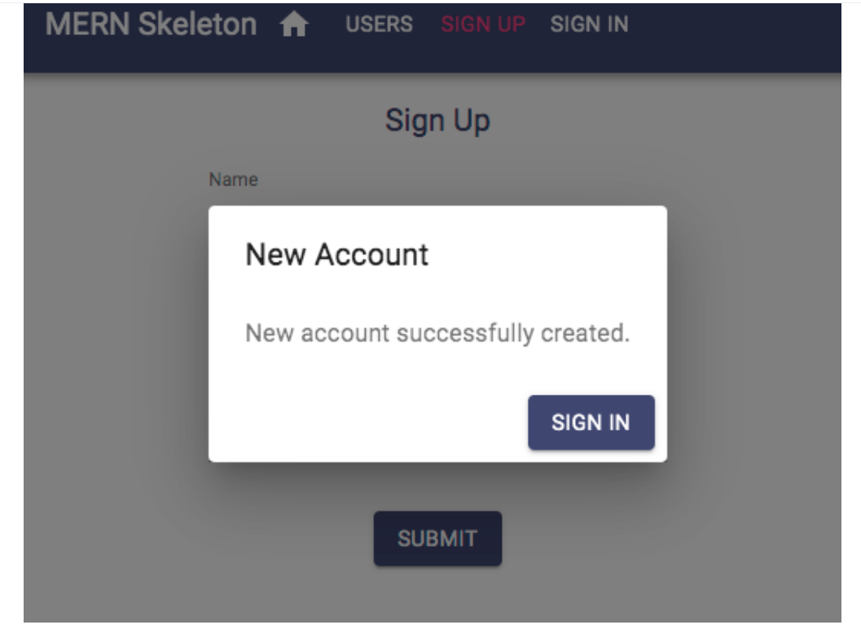
On successful account creation, the user is given confirmation and asked to sign in using this Dialog component, which links to the Signin component, as shown in the following screenshot:

Slide 48
To add the Signup component to the app, add the following Route to MainRouter.

Slide 49
mern-skeleton/client/MainRouter.jsx:
<Route path="/signup" element={Signup}/>

Slide 50
Updated mern-skeleton/client/MainRouter.jsx:
import React from 'react'
import {Route, Routes} from 'react-router-dom'
import Home from './core/Home'
import Users from './user/Users.jsx'
import Signup from './user/Signup.jsx'
const MainRouter = () => {
return ( <div>
<Routes>
<Route exact path="/" element={<Home />} />
<Route path="/users" element={Users} />
<Route path="/signup" element={Signup}/>
</Routes>
</div>
)
}
export default MainRouter

Slide 51
This will render the Signup view at '/signup'. Similarly, we will implement the Signin component next.

Slide 52
The Signin component
The Signin component in client/lib/Signin.jsx is also a form with only email and password fields for signing in.
This component is quite similar to the Signup component and will render at the '/signin' path.
The key difference is in the implementation of redirection after a successful sign-in and storing the received JWT credentials.
The rendered Signin component can be seen in the following screenshot:

Slide 53
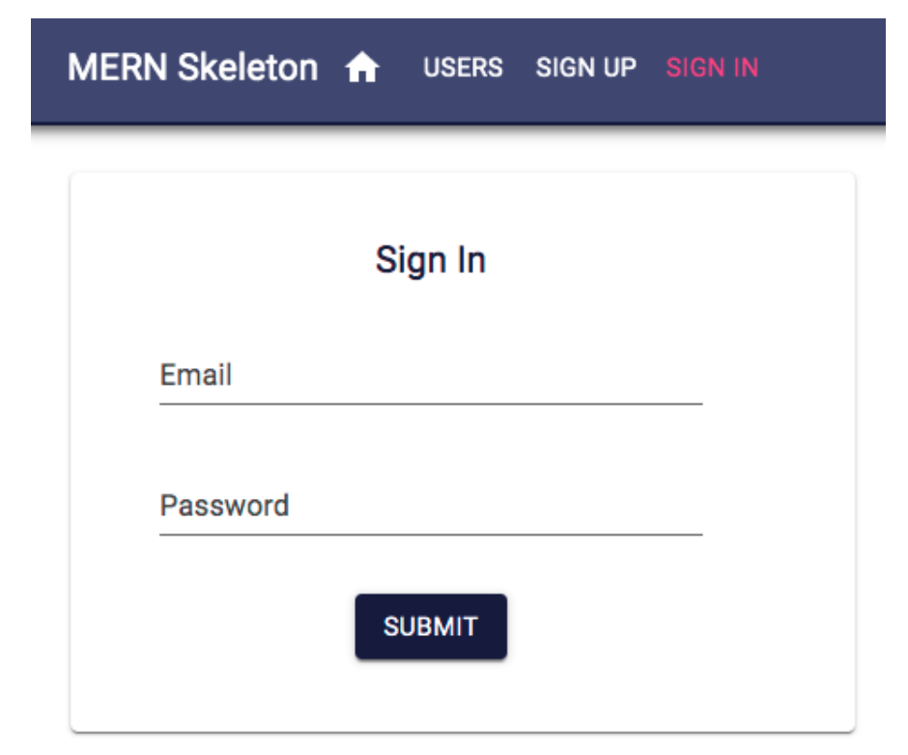

Slide 54
Updated mern-skeleton/client/lib/Signin.jsx:
import React, {useState} from 'react'
import Card from '@material-ui/core/Card'
import CardActions from '@material-ui/core/CardActions'
import CardContent from '@material-ui/core/CardContent'
import Button from '@material-ui/core/Button'
import TextField from '@material-ui/core/TextField'
import Typography from '@material-ui/core/Typography'
import Icon from '@material-ui/core/Icon'
import { makeStyles } from '@material-ui/core/styles'
import auth from './auth-helper.js'
import {Navigate} from 'react-router-dom'
import { useLocation } from 'react-router-dom';
import {signin} from './api-auth.js'
const useStyles = makeStyles(theme => ({
card: {
maxWidth: 600,
margin: 'auto',
textAlign: 'center',
marginTop: theme.spacing(5),
paddingBottom: theme.spacing(2)
},
error: {
verticalAlign: 'middle'
},
title: {
marginTop: theme.spacing(2),
color: theme.palette.openTitle
},
textField: {
marginLeft: theme.spacing(1),
marginRight: theme.spacing(1),
width: 300
},
submit: {
margin: 'auto',
marginBottom: theme.spacing(2)
}
}))
export default function Signin(props) {
const location = useLocation();
console.log(location.state)
const classes = useStyles()
const [values, setValues] = useState({
email: '',
password: '',
error: '',
redirectToReferrer: false
})
const clickSubmit = () => {
const user = {
email: values.email || undefined,
password: values.password || undefined
}
console.log(user)
signin(user).then((data) => {
if (data.error) {
setValues({ ...values, error: data.error})
} else {
console.log(data)
auth.authenticate(data, () => {
setValues({ ...values, error: '',redirectToReferrer: true})
})
}
})
}
const handleChange = name => event => {
setValues({ ...values, [name]: event.target.value })
}
const {from} = location.state || {
from: {
pathname: '/'
}
}
const {redirectToReferrer} = values
if (redirectToReferrer) {
return <Navigate to={from}/>;
}
return (
<Card className={classes.card}>
<CardContent>
<Typography variant="h6" className={classes.title}>
Sign In
</Typography>
<TextField id="email" type="email" label="Email" className={classes.textField} value={values.email} onChange={handleChange('email')} margin="normal"/><br/>
<TextField id="password" type="password" label="Password" className={classes.textField} value={values.password} onChange={handleChange('password')} margin="normal"/>
<br/> {
values.error && (<Typography component="p" color="error">
<Icon color="error" className={classes.error}>error</Icon>
{values.error}
</Typography>)
}
</CardContent>
<CardActions>
<Button color="primary" variant="contained" onClick={clickSubmit} className={classes.submit}>Submit</Button>
</CardActions>
</Card>
)
}

Slide 55
To add the Signin component to the app, add the following Route to MainRouter.
mern-skeleton/client/MainRouter.jsx:
<Route path="/signin" element={Signin}/>

Slide 56
Updated mern-skeleton/client/MainRouter.jsx:
import React from 'react'
import {Route, Routes} from 'react-router-dom'
import Home from './core/Home'
import Users from './user/Users.jsx'
import Signup from './user/Signup.jsx'
import Signin from ‘./lib/Signin.jsx'
const MainRouter = () => {
return ( <div>
<Routes>
<Route exact path="/" element={<Home />} />
<Route path="/users" element={Users} />
<Route path="/signup" element={Signup} />
<Route path="/signin" element={Signin}/>
</Routes>
</div>
)
}
export default MainRouter

Slide 57
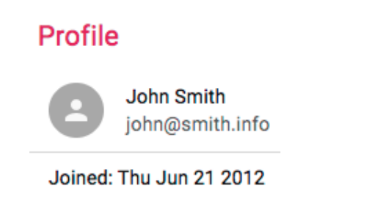
The Profile component
The Profile component in client/user/Profile.jsx shows a single user's information in the view at the '/user/:userId' path, where the userId parameter represents the ID of the specific user.
The completed Profile will display user details, and also conditionally show edit/delete options.
The following screenshot shows how the Profile renders when the user currently browsing is viewing someone else's profile and not their own profile:

Slide 58
This profile information can be fetched from the server if the user is signed in.
To verify this, the component has to provide the JWT credential to the read fetch call; otherwise, the user should be redirected to the Sign In view.
In the Profile component definition, we need to initialize the state with an empty user and set redirectToSignin to false.

Slide 59
Updated mern-skeleton/client/user/Profile.jsx
//import React, { useState } from 'react';
import auth from './auth/auth-helper.js';
import React, { useState,useEffect } from 'react';
import { Redirect } from 'react-router-dom';
import { read } from './someApiModule'; // Replace with the actual module that contains the read function
//import useState from 'react'
import read from 'react';
import match from 'react';
import setUser from 'react';
import setRedirectToSignin from 'react';
export default function Profile({ match }) {
//...
const [user, setUser] = useState({})
const [redirectToSignin, setRedirectToSignin] = useState(false)
//...
}
useEffect(() => {
const abortController = new AbortController()
const signal = abortController.signal
const jwt = auth.isAuthenticated()
read({
userId: match.params.userId
}, {t: jwt.token}, signal).then((data) => {
if (data && data.error) {
setRedirectToSignin(true)
} else {
setUser(data)
}
})
return function cleanup(){
abortController.abort()
}
}, [match.params.userId])
if (redirectToSignin) {
return <Redirect to='/signin'/>
}
return (
<Paper className={classes.root} elevation={4}>
<Typography variant="h6" className={classes.title}>
Profile
</Typography>
<List dense>
<ListItem>
<ListItemAvatar>
<Avatar>
<Person/>
</Avatar>
</ListItemAvatar>
<ListItemText primary={user.name} secondary={user.email}/>
</ListItem>
<Divider/>
<ListItem>
<ListItemText primary={"Joined: " + (
new Date(user.created)).toDateString()}/>
</ListItem>
</List>
</Paper>
)

Slide 60
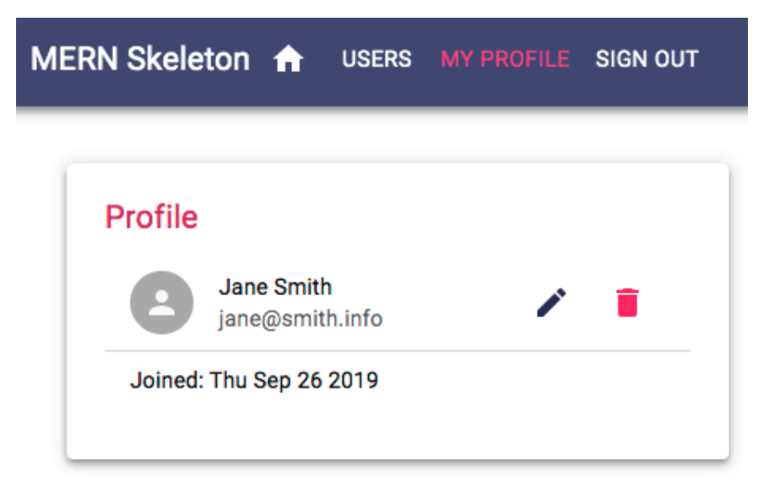
However, if the user that's currently signed in is viewing their own profile, they will be able to see edit and delete options in the Profile component, as shown in the following screen shot:

Slide 61
Updated mern-skeleton/client/user/Profile.jsx:
/* eslint-disable react/prop-types */
import React, { useState, useEffect } from 'react'
import { makeStyles } from '@material-ui/core/styles'
import Paper from '@material-ui/core/Paper'
import List from '@material-ui/core/List'
import ListItem from '@material-ui/core/ListItem'
import ListItemAvatar from '@material-ui/core/ListItemAvatar'
import ListItemSecondaryAction from '@material-ui/core/ListItemSecondaryAction'
import ListItemText from '@material-ui/core/ListItemText'
import Avatar from '@material-ui/core/Avatar'
import IconButton from '@material-ui/core/IconButton'
import Typography from '@material-ui/core/Typography'
import Edit from '@material-ui/icons/Edit'
import Person from '@material-ui/icons/Person'
import Divider from '@material-ui/core/Divider'
import DeleteUser from './DeleteUser'
import auth from '../lib/auth-helper.js'
import {read} from './api-user.js'
import {useLocation, Navigate, Link} from 'react-router-dom'
import { useParams } from 'react-router-dom';
const useStyles = makeStyles(theme => ({
root: theme.mixins.gutters({
maxWidth: 600,
margin: 'auto',
padding: theme.spacing(3),
marginTop: theme.spacing(5)
}),
title: {
marginTop: theme.spacing(3),
color: theme.palette.protectedTitle
}
}))
export default function Profile({ match }) {
const location = useLocation();
const classes = useStyles()
const [user, setUser] = useState({})
const [redirectToSignin, setRedirectToSignin] = useState(false)
const jwt = auth.isAuthenticated()
const { userId } = useParams();
useEffect(() => {
const abortController = new AbortController()
const signal = abortController.signal
read({
userId: userId
}, {t: jwt.token}, signal).then((data) => {
if (data && data.error) {
setRedirectToSignin(true)
} else {
setUser(data)
}
})
return function cleanup(){
abortController.abort()
}
}, [userId])
if (redirectToSignin) {
return <Navigate to="/signin" state={{ from: location.pathname }} replace />;
}
if (auth.isAuthenticated()) {
console.log( auth.isAuthenticated().user._id)
console.log(user._id)
}
return (
<Paper className={classes.root} elevation={4}>
<Typography variant="h6" className={classes.title}>
Profile
</Typography>
<List dense>
<ListItem>
<ListItemAvatar>
<Avatar>
<Person/>
</Avatar>
</ListItemAvatar>
<ListItemText primary={user.name} secondary={user.email}/> {
auth.isAuthenticated().user && auth.isAuthenticated().user._id == user._id &&
(<ListItemSecondaryAction>
<Link to={"/user/edit/" + user._id}>
<IconButton aria-label="Edit" color="primary">
<Edit/>
</IconButton>
</Link>
<DeleteUser userId={user._id}/>
</ListItemSecondaryAction>)
}
</ListItem>
<Divider/>
<ListItem>
<ListItemText primary={"Joined: " + (
new Date(user.created)).toDateString()}/>
</ListItem>
</List>
</Paper>
)
}

Slide 62
The Edit button will route to the EditProfile component, while the custom DeleteUser component will handle the delete operation with the userId passed to it as a prop.
To add the Profile component to the app, add the Route to MainRouter.

Slide 63
mern-skeleton/client/MainRouter.jsx:
<Route path="/user/:userId" element={Profile}/>

Slide 64
Updated mern-skeleton/client/MainRouter.jsx:
import React from 'react'
import {Route, Routes} from 'react-router-dom'
import Home from './core/Home'
import Users from './user/Users.jsx'
import Signup from './user/Signup.jsx'
import Signin from ‘./lib/Signin.jsx'
import Profile from './user/Profile.jsx'
const MainRouter = () => {
return ( <div>
<Routes>
<Route exact path="/" element={<Home />} />
<Route path="/users" element={Users} />
<Route path="/signup" element={Signup} />
<Route path="/signin" element={Signin} />
<Route path="/user/:userId" element={Profile}/>
</Routes>
</div>
)
}
export default MainRouter

Slide 65
To visit this route in the browser and render a Profile with user details, the link should be composed with a valid user ID in it. In the next section, we will use this same approach of retrieving single user details and rendering it in the component to implement the Edit Profile view.

Slide 66
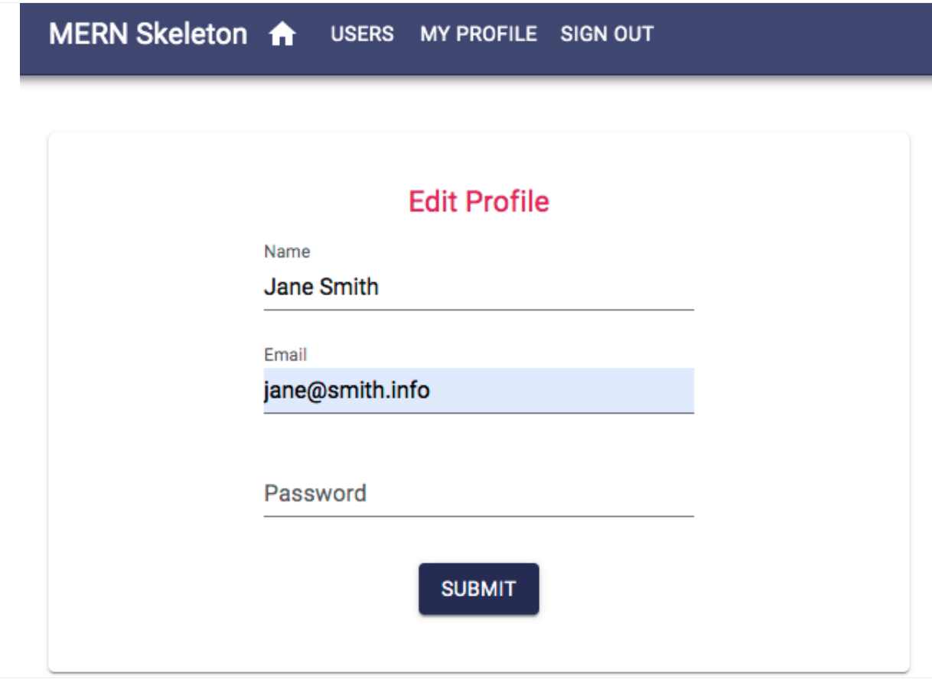
The EditProfile component
The EditProfile component in client/user/EditProfile.jsx has similarities in its implementation to both the Signup and Profile components.
It allows the authorized user to edit their own profile information in a form similar to the signup form, as shown in the following screenshot:

Slide 67
Upon loading at '/user/edit/:userId', the component will fetch the user's information with their ID after verifying JWT for auth, and then load the form with the received user information.
The form will allow the user to edit and submit only the changed information to the update fetch call, and, on successful update, redirect the user to the Profile view with updated information.
EditProfile will load the user information the same way as in the Profile component, that is, by fetching with read in useEffect using the userId parameter from match.params.
It will gather credentials from auth.isAuthenticated.

Slide 68
The form view will contain the same elements as the Signup component, with the input values being updated in the state when they change.
On form submit, the component will call the update fetch method with the userId, JWT and updated user data.

Slide 69
Updated mern-skeleton/client/user/EditProfile.jsx:
import React, {useState, useEffect} from 'react'
import Card from '@material-ui/core/Card'
import CardActions from '@material-ui/core/CardActions'
import CardContent from '@material-ui/core/CardContent'
import Button from '@material-ui/core/Button'
import TextField from '@material-ui/core/TextField'
import Typography from '@material-ui/core/Typography'
import Icon from '@material-ui/core/Icon'
import { makeStyles } from '@material-ui/core/styles'
import auth from '../lib/auth-helper.js'
import {read, update} from './api-user.js'
import {Navigate} from 'react-router-dom'
import { useParams } from 'react-router-dom';
const useStyles = makeStyles(theme => ({
card: {
maxWidth: 600,
margin: 'auto',
textAlign: 'center',
marginTop: theme.spacing(5),
paddingBottom: theme.spacing(2)
},
title: {
margin: theme.spacing(2),
color: theme.palette.protectedTitle
},
error: {
verticalAlign: 'middle'
},
textField: {
marginLeft: theme.spacing(1),
marginRight: theme.spacing(1),
width: 300
},
submit: {
margin: 'auto',
marginBottom: theme.spacing(2)
}
}))
export default function EditProfile() {
const classes = useStyles()
const { userId } = useParams();
const [values, setValues] = useState({
name: '',
password: '',
email: '',
open: false,
error: '',
NavigateToProfile: false
})
const jwt = auth.isAuthenticated()
useEffect(() => {
const abortController = new AbortController()
const signal = abortController.signal
read({
userId: userId
}, {t: jwt.token}, signal).then((data) => {
if (data && data.error) {
setValues({...values, error: data.error})
} else {
setValues({...values, name: data.name, email: data.email})
}
})
return function cleanup(){
abortController.abort()
}
}, [userId])
const clickSubmit = () => {
const user = {
name: values.name || undefined,
email: values.email || undefined,
password: values.password || undefined
}
update({
userId: userId
}, {
t: jwt.token
}, user).then((data) => {
if (data && data.error) {
setValues({...values, error: data.error})
} else {
setValues({...values, userId: data._id, NavigateToProfile: true})
}
})
}
const handleChange = name => event => {
setValues({...values, [name]: event.target.value})
}
if (values.NavigateToProfile) {
return (<Navigate to={'/user/' + values.userId}/>)
}
return (
<Card className={classes.card}>
<CardContent>
<Typography variant="h6" className={classes.title}>
Edit Profile
</Typography>
<TextField id="name" label="Name" className={classes.textField} value={values.name} onChange={handleChange('name')} margin="normal"/><br/>
<TextField id="email" type="email" label="Email" className={classes.textField} value={values.email} onChange={handleChange('email')} margin="normal"/><br/>
<TextField id="password" type="password" label="Password" className={classes.textField} value={values.password} onChange={handleChange('password')} margin="normal"/>
<br/> {
values.error && (<Typography component="p" color="error">
<Icon color="error" className={classes.error}>error</Icon>
{values.error}
</Typography>)
}
</CardContent>
<CardActions>
<Button color="primary" variant="contained" onClick={clickSubmit} className={classes.submit}>Submit</Button>
</CardActions>
</Card>
)
}

Slide 70
To add the EditProfile component to the app, we will use a PrivateRoute, which will restrict the component from loading at all if the user is not signed in.
The order of placement in MainRouter will also be important.

Slide 71
mern-skeleton/client/MainRouter.jsx:
<Route
path="/user/edit/:userId"
element={
<PrivateRoute>
<EditProfile />
</PrivateRoute>
}
/>
<Route path="/user/:userId" element={Profile}/>

Slide 72
Updated mern-skeleton/client/MainRouter.jsx:
import React from 'react'
import {Route, Routes} from 'react-router-dom'
import Home from './core/Home'
import Users from './user/Users.jsx'
import Signup from './user/Signup.jsx'
import Signin from ‘./lib/Signin.js'
import Profile from './user/Profile.js’
//import Switch from 'react'
import PrivateRoute from './lib/PrivateRoute.jsx'
import EditProfile from './user/EditProfile.jsx'
const MainRouter = () => {
return ( <div>
<Routes>
<Route exact path="/" element={<Home />} />
<Route path="/users" element={Users} />
<Route path="/signup" element={Signup} />
<Route path="/signin" element={Signin} />
<PrivateRoute path="/user/edit/:userId" element={EditProfile}/>
<Route path="/user/:userId" element={Profile}/>
</Routes>
</div>
)
}
export default MainRouter

Slide 73
The route with the '/user/edit/:userId' path needs to be placed before the route with the '/user/:userId' path, so that the edit path is matched first exclusively when this route is requested, and not confused with the Profile route.
With this profile edit view added, we only have the user delete UI implementation left to complete the user-related frontend.

Slide 74
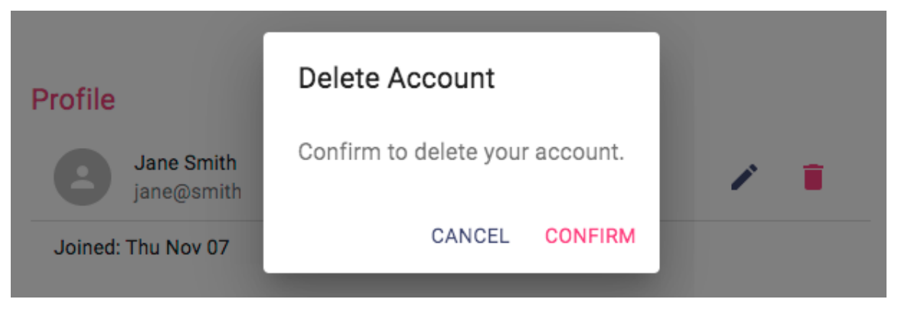
The DeleteUser component
The DeleteUser component in client/user/DeleteUser.jsx is basically a button that we will add to the Profile view that, when clicked, opens a Dialog component asking the user to confirm the delete action, as shown in the following screenshot:

Slide 75
This component initializes the state with open set to false for the Dialog component, as well as redirect set to false so that it isn't rendered first.

Slide 76
Updated mern-skeleton/client/user/DeleteUser.jsx:
import React, {useState} from 'react'
import PropTypes from 'prop-types'
import IconButton from '@material-ui/core/IconButton'
import Button from '@material-ui/core/Button'
import DeleteIcon from '@material-ui/icons/Delete'
import Dialog from '@material-ui/core/Dialog'
import DialogActions from '@material-ui/core/DialogActions'
import DialogContent from '@material-ui/core/DialogContent'
import DialogContentText from '@material-ui/core/DialogContentText'
import DialogTitle from '@material-ui/core/DialogTitle'
import auth from ‘../lib/auth-helper.js'
import {remove} from './api-user.js'
import {Navigate} from 'react-router-dom'
export default function DeleteUser(props) {
const [open, setOpen] = useState(false)
const [redirect, setRedirect] = useState(false)
const jwt = auth.isAuthenticated()
const clickButton = () => {
setOpen(true)
}
const deleteAccount = () => {
remove({
userId: props.userId
}, {t: jwt.token}).then((data) => {
if (data && data.error) {
console.log(data.error)
} else {
auth.clearJWT(() => console.log('deleted'))
setRedirect(true)
}
})
}
const handleRequestClose = () => {
setOpen(false)
}
if (redirect) {
return <Navigate to='/'/>
}
return (<span>
<IconButton aria-label="Delete" onClick={clickButton} color="secondary">
<DeleteIcon/>
</IconButton>
<Dialog open={open} onClose={handleRequestClose}>
<DialogTitle>{"Delete Account"}</DialogTitle>
<DialogContent>
<DialogContentText>
Confirm to delete your account.
</DialogContentText>
</DialogContent>
<DialogActions>
<Button onClick={handleRequestClose} color="primary">
Cancel
</Button>
<Button onClick={deleteAccount} color="secondary" autoFocus="autoFocus">
Confirm
</Button>
</DialogActions>
</Dialog>
</span>)
}
DeleteUser.propTypes = {
userId: PropTypes.string.isRequired
}

Slide 78
Since we are using the DeleteUser component in the Profile component, it gets added to the application view when Profile is added in MainRouter.
With the delete user UI added, we now have a frontend that contains all the React component views in order to complete the skeleton application features.
But, we still need a common navigation UI to link all these views together and make each view easy to access for the frontend user.
In the next section, we will implement this navigation menu component.

Slide 79
The Menu component
The Menu component will function as a navigation bar across the frontend application by providing links to all the available views, and also by indicating the user's current location in the application.
To implement these navigation bar functionalities, we will use the HOC withRouter from React Router to get access to the history object's properties.
The following code in the Menu component adds just the title, the Home icon linked to the root route, and the Users button, which is linked to the '/users' route.

Slide 80
mern-skeleton/client/core/Menu.jsx:
const Menu = withRouter(({history}) => (
<AppBar position="static">
<Toolbar>
<Typography variant="h6" color="inherit">
MERN Skeleton
</Typography>
<Link to="/">
<IconButton aria-label="Home" style={isActive(history, "/")}>
<HomeIcon/>
</IconButton>
</Link>
<Link to="/users">
<Button style={isActive(history, "/users")}>Users</Button>
</Link>
</Toolbar>
</AppBar>))

Slide 81
Updated mern-skeleton/client/core/Menu.jsx:
import withRouter from 'react'
import AppBar from 'react'
import Toolbar from 'react'
import Typography from 'react'
import Link from 'react'
import IconButton from 'react'
import isActive from 'react'
import HomeIcon from 'react'
import Button from 'react'
const Menu = withRouter(({ history }) => (
<AppBar position="static">
<Toolbar>
<Typography variant="h6" color="inherit">
MERN Skeleton
</Typography>
<Link to="/">
<IconButton aria-label="Home" style={isActive(history, "/")}>
<HomeIcon/>
</IconButton>
</Link>
<Link to="/users">
<Button style={isActive(history, "/users")}>Users</Button>
</Link>
</Toolbar>
</AppBar>))

Slide 82
To indicate the current location of the application on the Menu, we will highlight the link that matches the current location path by changing the color conditionally.

Slide 83
mern-skeleton/client/core/Menu.jsx:
const isActive = (history, path) => {
if (history.location.pathname == path)
return {color: '#ff4081'}
else
return {color: '#ffffff'}
}

Slide 84
Updated mern-skeleton/client/core/Menu.jsx:
import withRouter from 'react'
import AppBar from 'react'
import Toolbar from 'react'
import Typography from 'react'
import Link from 'react'
import IconButton from 'react'
//import isActive from 'react'
import HomeIcon from 'react'
import Button from 'react'
const Menu = withRouter(({ history }) => (
<AppBar position="static">
<Toolbar>
<Typography variant="h6" color="inherit">
MERN Skeleton
</Typography>
<Link to="/">
<IconButton aria-label="Home" style={isActive(history, "/")}>
<HomeIcon/>
</IconButton>
</Link>
<Link to="/users">
<Button style={isActive(history, "/users")}>Users</Button>
</Link>
</Toolbar>
</AppBar>))
const isActive = (history, path) => {
if (history.location.pathname == path)
return {color: '#ff4081'}
else
return {color: '#ffffff'}
}

Slide 85
The isActive function is used to apply color to the buttons in the Menu, as follows:
style={isActive(history, "/users")} – This line of script already exist in the Menu.jsx

Slide 86

The remaining links such as SIGN IN, SIGN UP, MY PROFILE, and SIGN OUT will show up on the Menu based on whether the user is signed in or not.
The following screenshot shows how the Menu renders when the user is not signed in:
For example, the links to SIGN UP and SIGN IN should only appear on the menu when the user is not signed in.
Therefore, we need to add it to the Menu component after the Users button with a condition.

Slide 87
mern-skeleton/client/core/Menu.jsx:
{
!auth.isAuthenticated() && (<span>
<Link to="/signup">
<Button style={isActive(history, "/signup")}> Sign Up </Button>
</Link>
<Link to="/signin">
<Button style={isActive(history, "/signin")}> Sign In </Button>
</Link>
</span>)
}

Slide 88
Updated mern-skeleton/client/core/Menu.jsx:
import withRouter from 'react'
import AppBar from 'react'
import Toolbar from 'react'
import Typography from 'react'
import Link from 'react'
import IconButton from 'react'
//import isActive from 'react'
import HomeIcon from 'react'
import Button from 'react'
import auth from 'auth'
const Menu = withRouter(({ history }) => (
<AppBar position="static">
<Toolbar>
<Typography variant="h6" color="inherit">
MERN Skeleton
</Typography>
<Link to="/">
<IconButton aria-label="Home" style={isActive(history, "/")}>
<HomeIcon/>
</IconButton>
</Link>
<Link to="/users">
<Button style={isActive(history, "/users")}>Users</Button>
</Link>
</Toolbar>
</AppBar>))
const isActive = (history, path) => {
if (history.location.pathname == path)
return {color: '#ff4081'}
else
return {color: '#ffffff'}
}
{
!auth.isAuthenticated() && (<span>
<Link to="/signup">
<Button style={isActive(history, "/signup")}> Sign Up </Button>
</Link>
<Link to="/signin">
<Button style={isActive(history, "/signin")}> Sign In </Button>
</Link>
</span>)
}

Slide 89
Similarly, the link to MY PROFILE and the SIGN OUT button should only appear on the menu when the user is signed in, and should be added to the Menu component with the following condition check.

Slide 90
mern-skeleton/client/core/Menu.jsx:
{
auth.isAuthenticated() && (<span>
<Link to={"/user/" + auth.isAuthenticated().user._id}>
<Button style={isActive(history, "/user/"
+ auth.isAuthenticated().user._id)}>
My Profile
</Button>
</Link>
<Button color="inherit"
onClick={() => { auth.clearJWT(() => history.push('/')) }}>
Sign out
</Button>
</span>)
}

Slide 91
Updated mern-skeleton/client/core/Menu.jsx:
import React from 'react'
import AppBar from '@material-ui/core/AppBar'
import Toolbar from '@material-ui/core/Toolbar'
import Typography from '@material-ui/core/Typography'
import IconButton from '@material-ui/core/IconButton'
import HomeIcon from '@material-ui/icons/Home'
import Button from '@material-ui/core/Button'
import auth from ‘../lib/auth-helper'
import { Link, useNavigate, useLocation } from 'react-router-dom';
const isActive = (location, path) => {
return location.pathname === path ? { color: '#ff4081' } : { color: '#ffffff' };
};
export default function Menu(){
const navigate = useNavigate();
const location = useLocation();
return (
<AppBar position="static">
<Toolbar>
<Typography variant="h6" color="inherit">
MERN Skeleton
</Typography>
<Link to="/">
<IconButton aria-label="Home" style={isActive(location, "/")}>
<HomeIcon/>
</IconButton>
</Link>
<Link to="/users">
<Button style={isActive(location, "/users")}>Users</Button>
</Link>
{
!auth.isAuthenticated() && (<span>
<Link to="/signup">
<Button style={isActive(location, "/signup")}>Sign up
</Button>
</Link>
<Link to="/signin">
<Button style={isActive(location, "/signin")}>Sign In
</Button>
</Link>
</span>)
}
{
auth.isAuthenticated() && (<span>
<Link to={"/user/" + auth.isAuthenticated().user._id}>
<Button style={isActive(location, "/user/" + auth.isAuthenticated().user._id)}>My Profile</Button>
</Link>
<Button color="inherit" onClick={() => {
auth.clearJWT(() => navigate('/'));
}}>Sign out</Button>
</span>)
}
</Toolbar>
</AppBar>
);
}

Slide 92
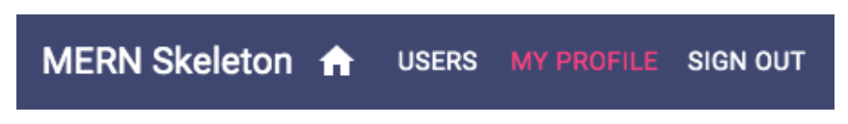
The MY PROFILE button uses the signed-in user's information to link to the user's own profile, while the SIGN OUT button calls the auth.clearJWT() method when it's clicked.
When the user is signed in, the Menu will look as follows:
To have the Menu navigation bar present in all the views, we need to add it to the MainRouter before all the other routes, and outside the Switch component.

Slide 93
mern-skeleton/client/MainRouter.jsx:
<Menu/>

Slide 94
Updated mern-skeleton/client/MainRouter.jsx:
import React from 'react';
import { Routes, Route } from 'react-router-dom';
//import React from 'react'
//import {Route, Routes} from 'react-router-dom'
import Home from './core/Home'
import Users from './user/Users.jsx'
import Signup from './user/Signup.jsx'
import Signin from './auth/Signin.jsx'
import Profile from './user/Profile.jsx'
import Switch from 'react'
import PrivateRoute from './lib/PrivateRoute.jsx'
import EditProfile from './user/EditProfile.jsx'
import Menu from './core/Menu'
function MainRouter() {
return (
<div>
<Menu/>
<Routes>
<Route path="/" element={<Home />} />
<Route path="/users" element={<Users />} />
<Route path="/signup" element={<Signup />} />
<Route path="/signin" element={<Signin />} />
<Route
path="/user/edit/:userId"
element={
<PrivateRoute>
<EditProfile />
</PrivateRoute>
}
/>
<Route path="/user/:userId" element={<Profile />} />
</Routes>
</div>
);
}
export default MainRouter;

Slide 95
This will make the Menu component render on top of all the other components when these components are accessed at their respective routes.
The skeleton frontend is now complete and has all necessary components to allow a user to sign up, view, and modify user data on the backend while considering authentication and authorization restrictions.
However, it is still not possible to visit the frontend routes directly in the browser address bar; these can only be accessed when they're linked from within the frontend view.
To enable this functionality in the skeleton application, we need to implement basic server-side rendering.

Slide 96
Implementing basic server-side rendering
Currently, when the React Router routes or pathnames are directly entered in the browser address bar or when a view that is not at the root path is refreshed, the URL does not work.
This happens because the server does not recognize the React Router routes we defined in the frontend.
We have to implement basic server-side rendering on the backend so that the server is able to respond when it receives a request to a frontend route.
To render the relevant React components properly when the server receives requests to the frontend routes, we need to initially generate the React components on the server-side with regard to the React Router and Material-UI components, before the client-side JS is ready to take over the rendering.

Slide 97
In the following sections, we will look at the implementation of the steps outlined in the preceding code block, and also discuss how to prepare the frontend so that it accepts and handles this server-rendered code.

Slide 98
While rendering the React tree, the client app's root component, MainRouter, is wrapped with the Material-UI ThemeProvider to provide the styling props that are needed by the MainRouter child components.
The stateless StaticRouter is used here instead of the BrowserRouter that's used on the client-side in order to
wrap MainRouter and provide the routing props that are used for implementing the client-side components.
Based on these values, such as the requested location route and theme that are passed in as props to the wrapping components, renderToString will return the
markup containing the relevant view.

Slide 99
An example of a case where redirect is rendered in the component is when we're trying to access a PrivateRoute via a server-side render.
As the server-side cannot access the auth token from the browser's sessionStorage, the redirect in PrivateRoute will render.
The context.url value , in this case, will have the '/signin' route, and hence, instead of trying to render the PrivateRoute component, it will redirect to the '/signin' route.
This completes the code we need to add to the server-side to enable the basic server-side rendering of the React views.
Next, we need to update the frontend so it is able to integrate and render this server-generated code.

Slide 100
Updated express.js
import express from 'express'
import bodyParser from 'body-parser'
import cookieParser from 'cookie-parser'
import compress from 'compression'
import cors from 'cors'
import helmet from 'helmet'
import Template from './../template.js'
import userRoutes from './routes/user.routes.js'
import authRoutes from './routes/auth.routes.js'
import path from 'path'
const app = express()
const CURRENT_WORKING_DIR = process.cwd()
/*app.get('/', (req, res) => {
res.status(200).send(Template())
})*/
app.use('/dist', express.static(path.join(CURRENT_WORKING_DIR, 'dist')))
app.use(express.json());
app.use(express.urlencoded({ extended: true }));
app.use('/', userRoutes)
app.use('/', authRoutes)
app.use(bodyParser.json())
app.use(bodyParser.urlencoded({ extended: true }))
app.use(cookieParser())
app.use(compress())
app.use(helmet())
app.use(cors())
app.use((err, req, res, next) => {
if (err.name === 'UnauthorizedError') {
res.status(401).json({"error" : err.name + ": " + err.message})
}else if (err) {
res.status(400).json({"error" : err.name + ": " + err.message})
console.log(err)
}
})
export default app

Slide 101
CONNECTING THE FRONTEND AND BACKEND
To connect the frontend and Backend since the backend(server) is running on port 3000, add the following code to the vite.config.js file as follows:

Slide 102
Vite.config.js
import { defineConfig } from "vite";
import react from "@vitejs/plugin-react";
const { PORT = 3000} = process.env;
export default defineConfig({
plugins: [react()],
server:{
proxy:{
'/api':{
target:`http://localhost:${PORT}`,
changeOrigin: true,
},
'/auth': {
target:`http://localhost:${PORT}`,
changeOrigin: true,
},
},
},
build: {
manifest: true,
rollupOptions: {
input: "./src/main.jsx",
},
},
});

Slide 103
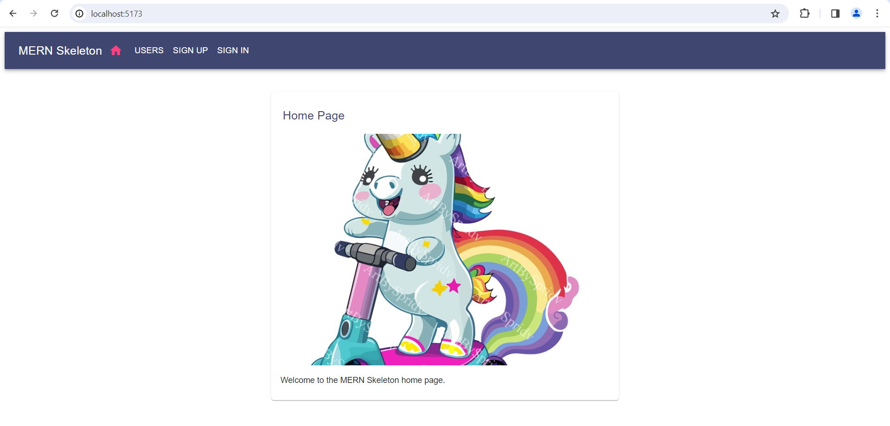

Slide 104
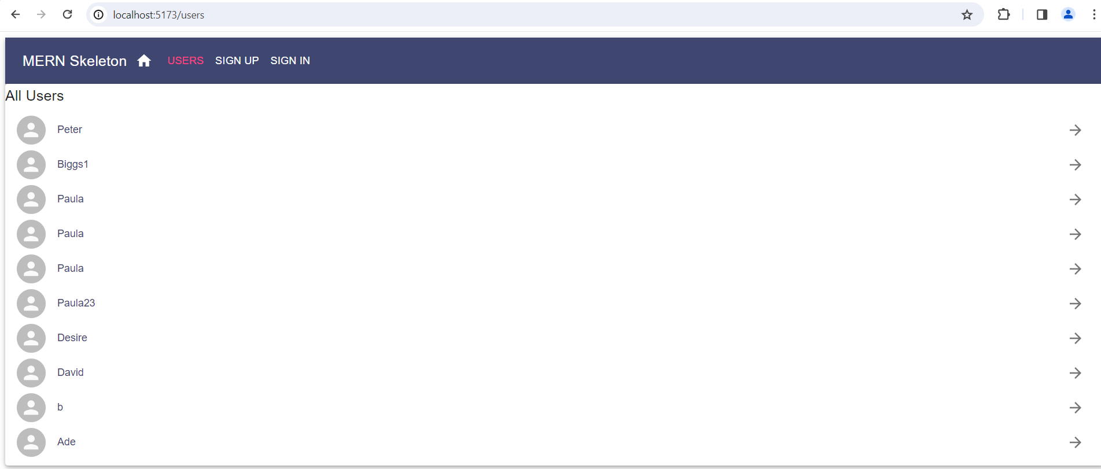

Slide 105
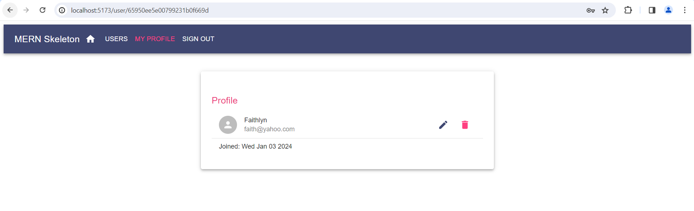
When you click on a signed in user the screen below is displayed, so you can edit or delete the profile.

Slide 106
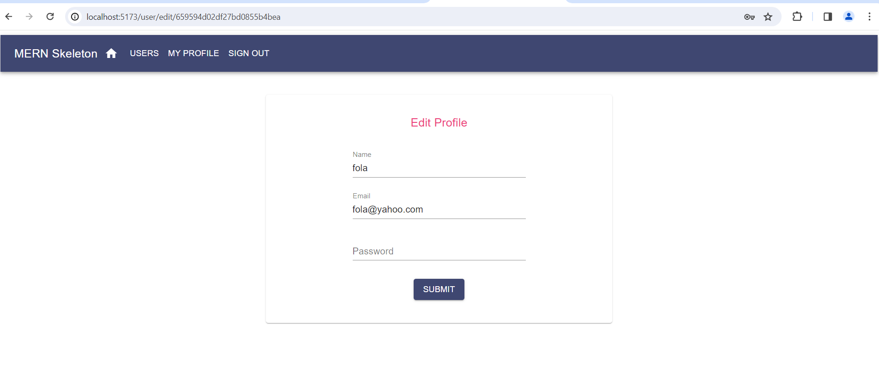
Edit Profile – Only signed in users can edit their profile.

Slide 107
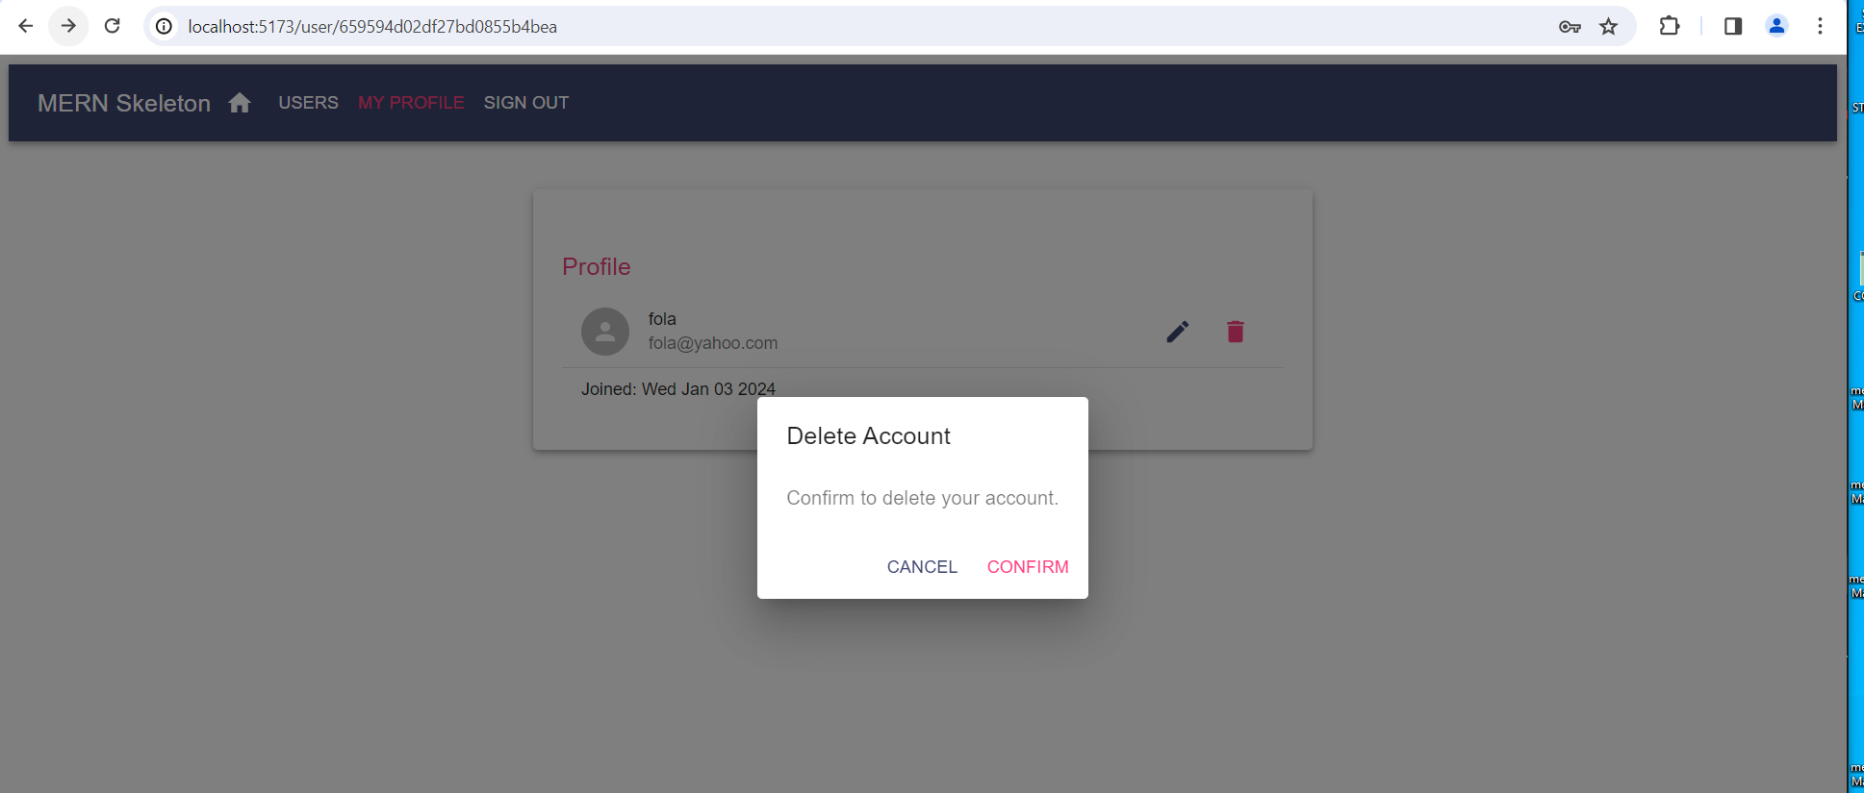
Delete Profile

